Slide 1
LibreOffice Development Workshop
LibreOffice Automation with Basic and Python Scripts
Rafael Henrique Palma Lima
UTFPR / TDF Member

Slide 2
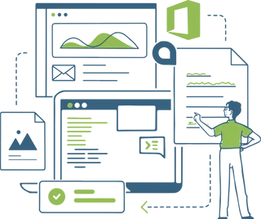
Agenda
This session is divided in three topics:
LibreOffice automation using Basic (Rafael Lima)
LibreOffice automation using Python (Alain Romedenne)
Using the ScriptForge library in Basic and Python (Jean-Pierre Ledure)

Slide 3
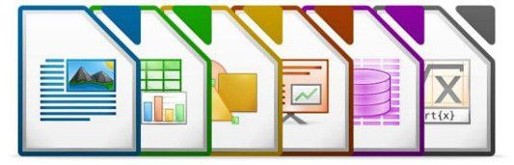
Why Scripting?
Automate common and repetitive tasks
Extend application functionalities (macros and extensions)
Interact directly with the LibreOffice API
Create custom applications tailored for your needs (integrate databases, create dialogs, forms, etc)

Slide 4
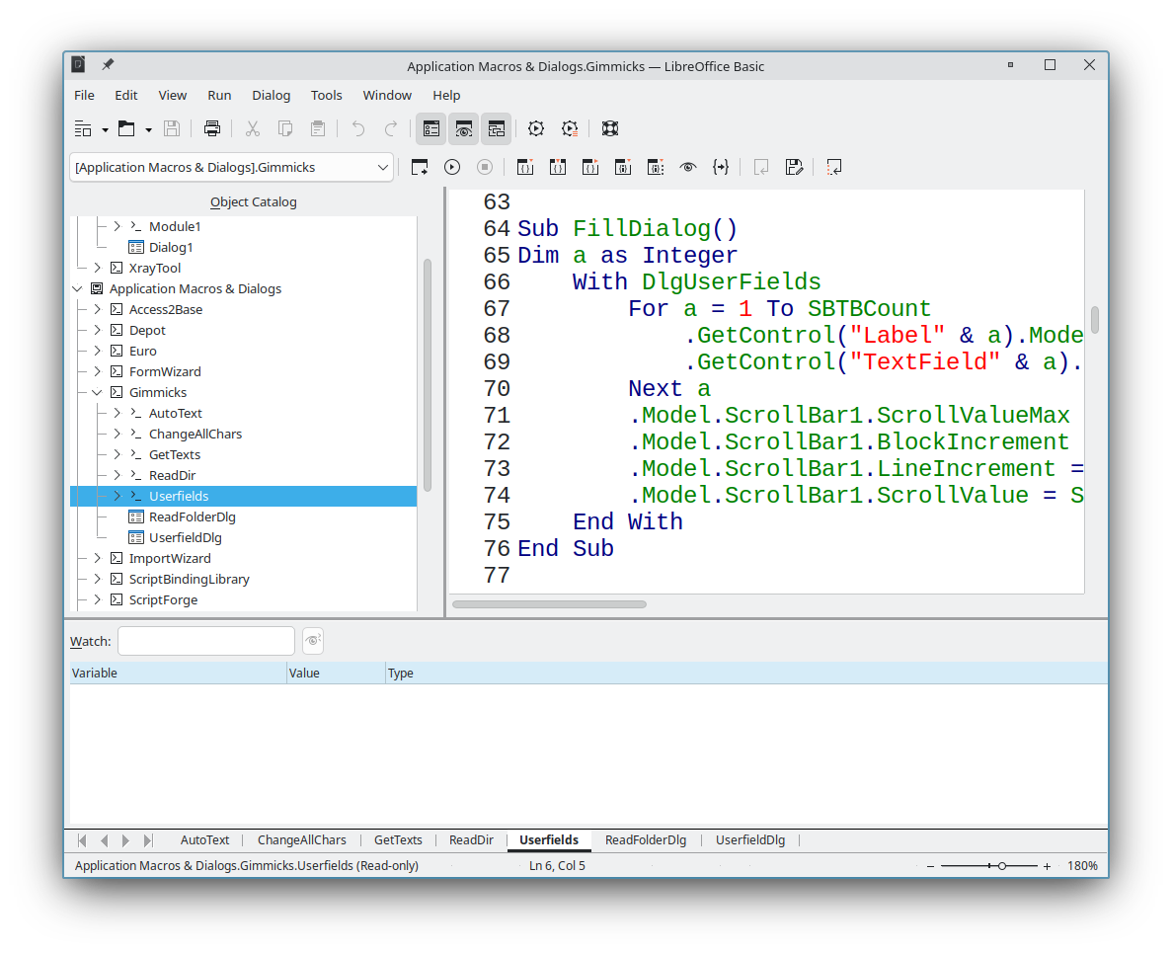
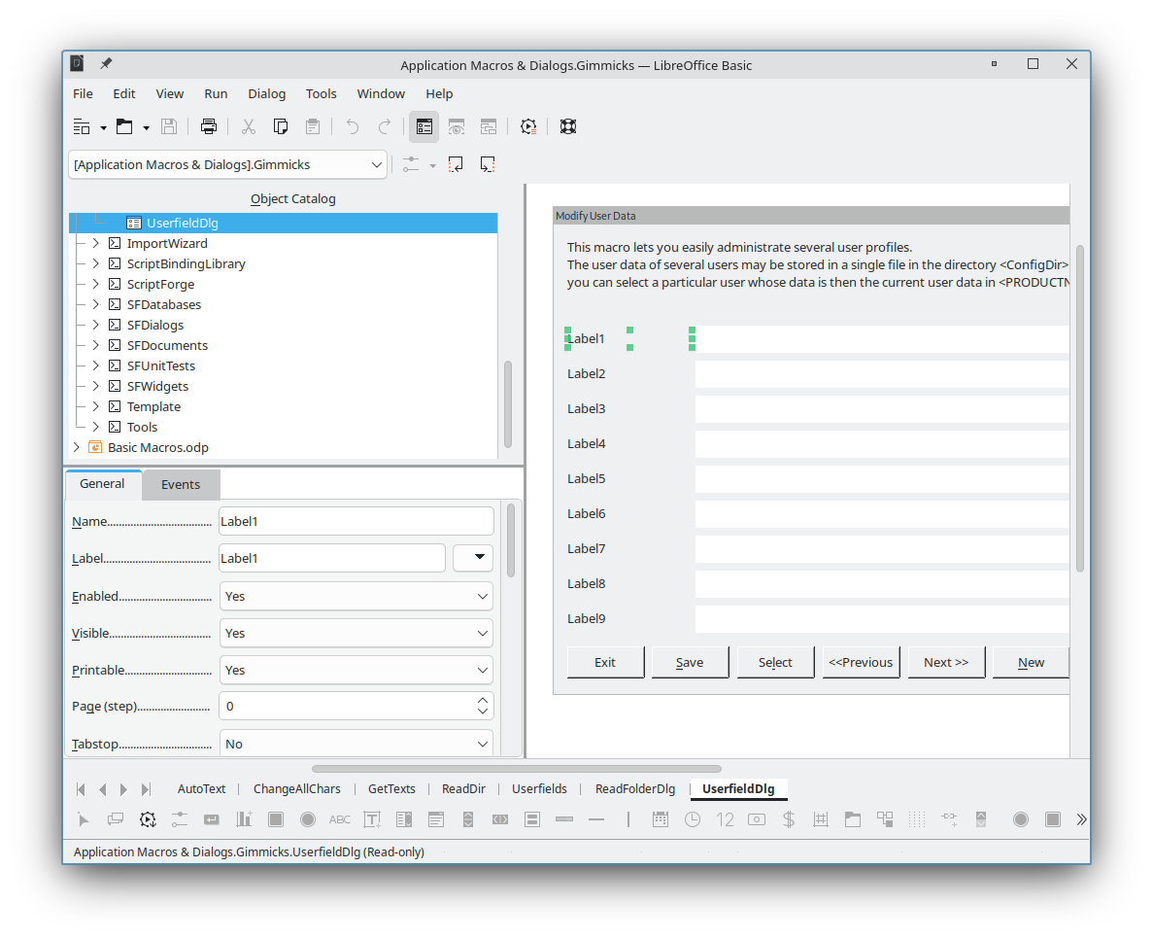
Scripting with Basic
LibreOffice has a built-in IDE for creating scripts with the Basic language
The Dialog Editor can be used to create and edit dialogs

Slide 5
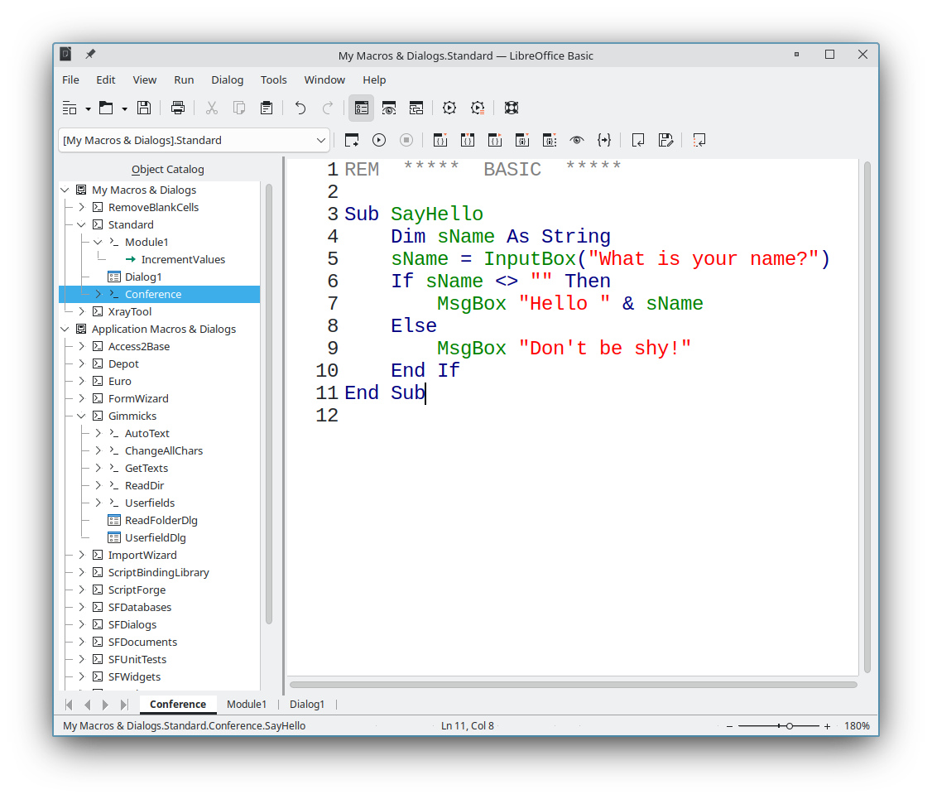
A “Hello World” script:
Open any LibreOffice application (f.i. open Calc)
Go to Tools – Macros – Edit Macros
A default module named “Module1” from the “Standard” library will be selected
Create the Sub SayHello by writing the next code
Place the cursor anywhere inside the newly created Sub
Click the Run button (or press F5)

Slide 6
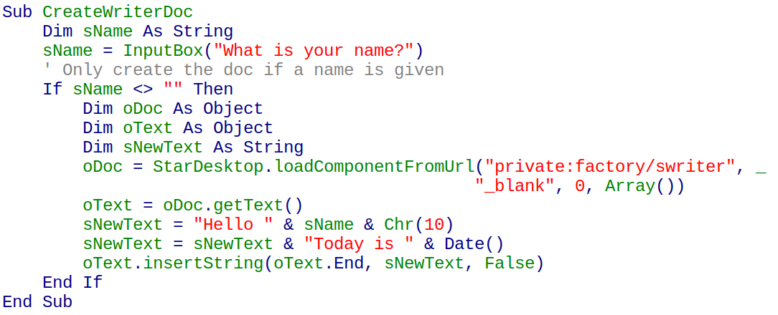
A more complex script: The following script creates a Writer document and inserts some text into it

Slide 7
How do I learn this?
StarDesktop: is a runtime object that gives access to the entire LibreOffice application
https://api.libreoffice.org/docs/idl/ref/servicecom_1_1sun_1_1star_1_1frame_1_1Desktop.html
https://wiki.documentfoundation.org/Documentation/DevGuide/LibreOffice_Basic#Accessing_the_UNO_API
LoadComponentFromURL
https://wiki.documentfoundation.org/Documentation/DevGuide/Text_Documents#Creating_and_Loading_Text_Documents

Slide 8
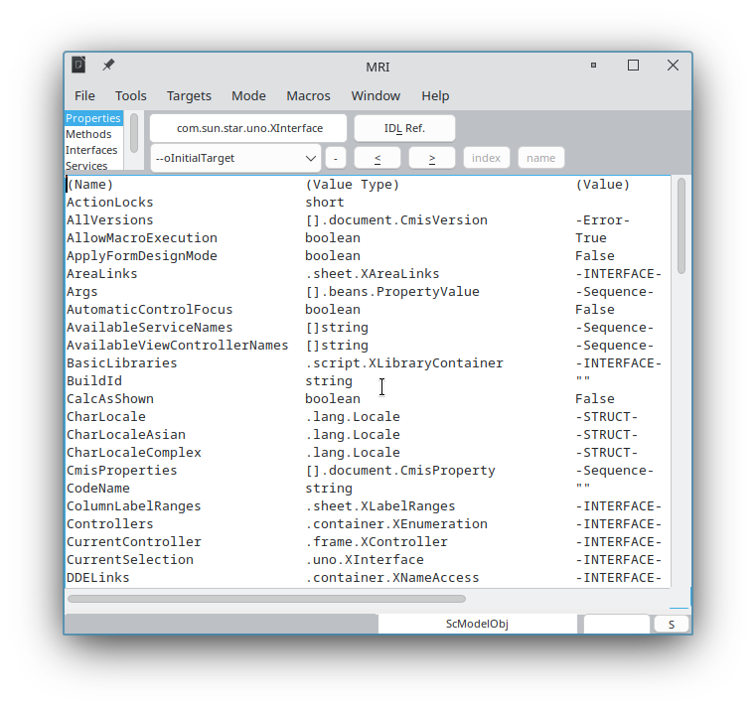
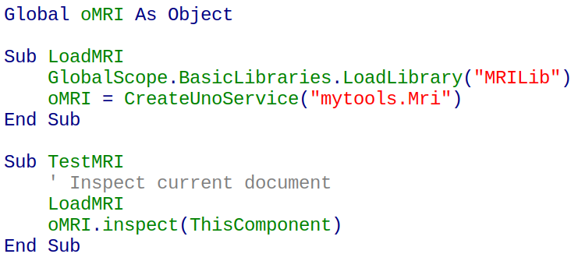
Inspecting Objects
Use the MRI or Xray extensions to inspect objects and discover its properties and methods
Download Link:
https://github.com/hanya/MRI

Slide 9
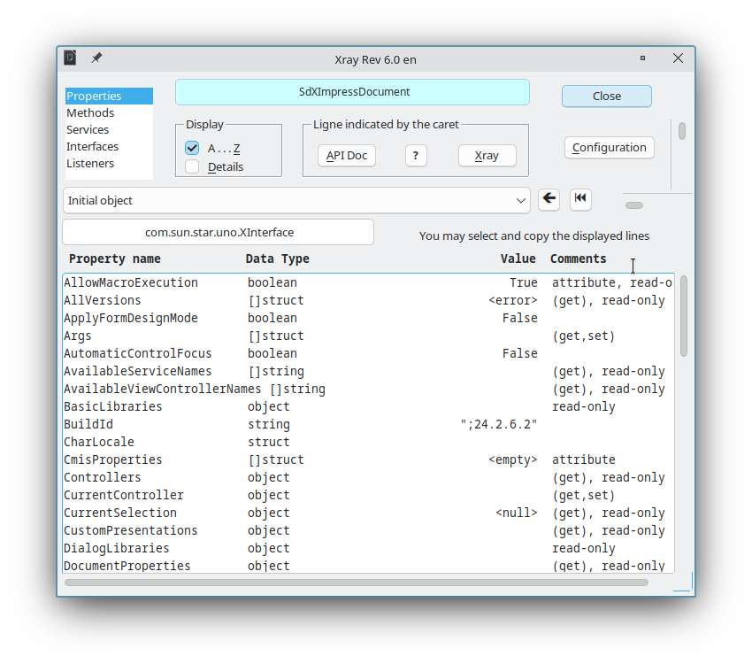
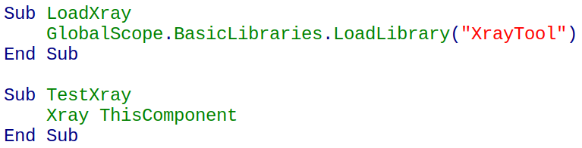
Inspecting Objects
Use the MRI or Xray extensions to inspect objects and discover its properties and methods
Download Link: https://github.com/rafaelhlima/basic_calc_tutorial/blob/main/external/XrayTool60_en.odt

Slide 10
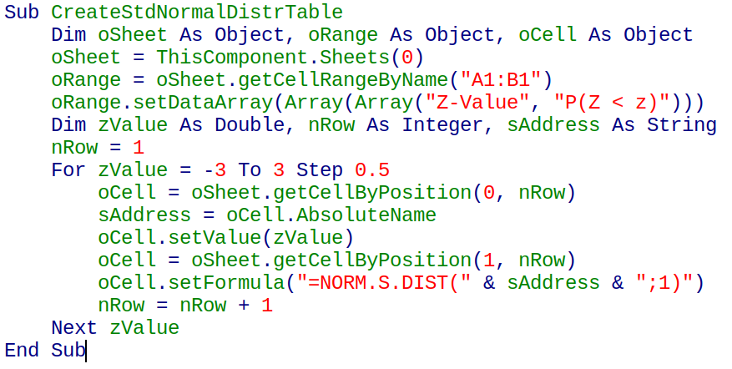
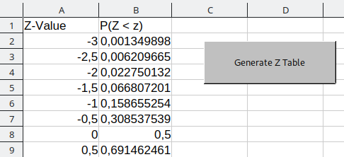
Spreadsheet Macros
Example of a Calc Macro that generates the Z distribution

Slide 11
Recording Macros
Steps to record a macro
Go to Tools – Options – Advanced and choose “Enable macro recording”
A new command “Record Macro” will be available in the Tools – Macros menu
Start recording the macro, make changes to the spreadsheet and click “Stop recording”
Save the code to a new Sub

Slide 12
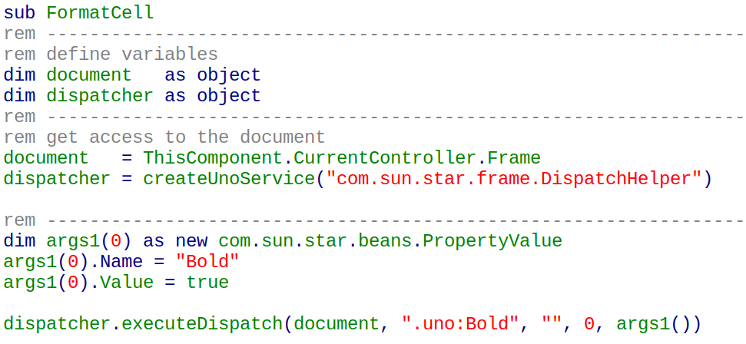
Recording Macros
Save the generated macro: recorded macros use UNO dispatch commands

Slide 13
Recording Macros
What can we do with the macro?
Run it via Tool – Macros – Run Macro
Associate the macro with a shape or control
Add the macro to a menu
Associate the macro with a shortcut
Add a toolbar entry with the macro

Slide 14
Dispatching UNO Commands
LibreOffice offers various UNO commands
Visit the link below for a list of all commands https://wiki.documentfoundation.org/Development/DispatchCommands
Read more about DispatchHelper here https://api.libreoffice.org/docs/idl/ref/interfacecom_1_1sun_1_1star_1_1frame_1_1XDispatchHelper.html

Slide 15
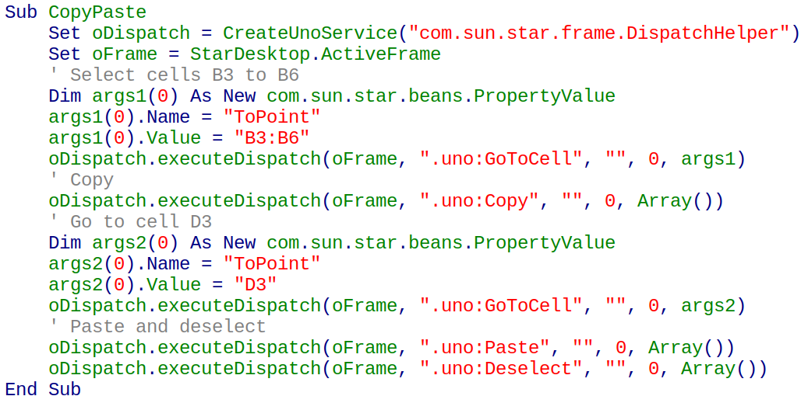
Dispatching UNO Commands

Slide 16
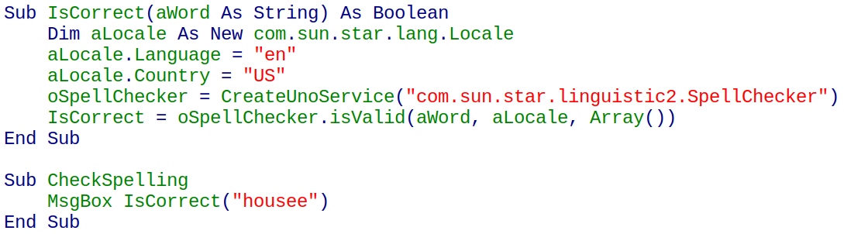
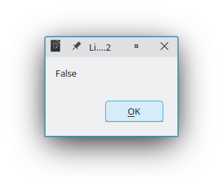
Using UNO Services
Example: using the SpellChecker service

Slide 17
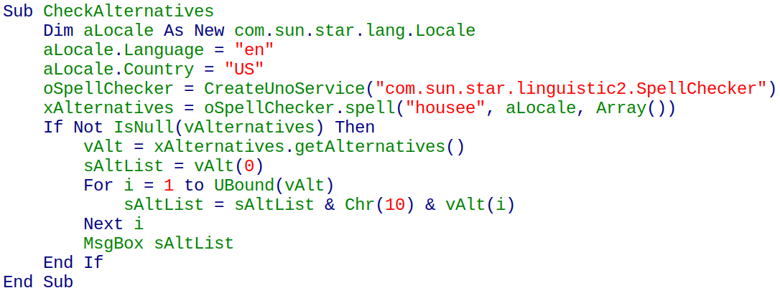
Example: getting SpellChecker suggestions

Slide 18
Using UNO Services
SpellCheker service
https://api.libreoffice.org/docs/idl/ref/servicecom_1_1sun_1_1star_1_1linguistic2_1_1SpellChecker.html
Locale struct
https://api.libreoffice.org/docs/idl/ref/structcom_1_1sun_1_1star_1_1lang_1_1Locale.html
XSpellAlternatives interface
https://api.libreoffice.org/docs/idl/ref/interfacecom_1_1sun_1_1star_1_1linguistic2_1_1XSpellAlternatives.html

Slide 19
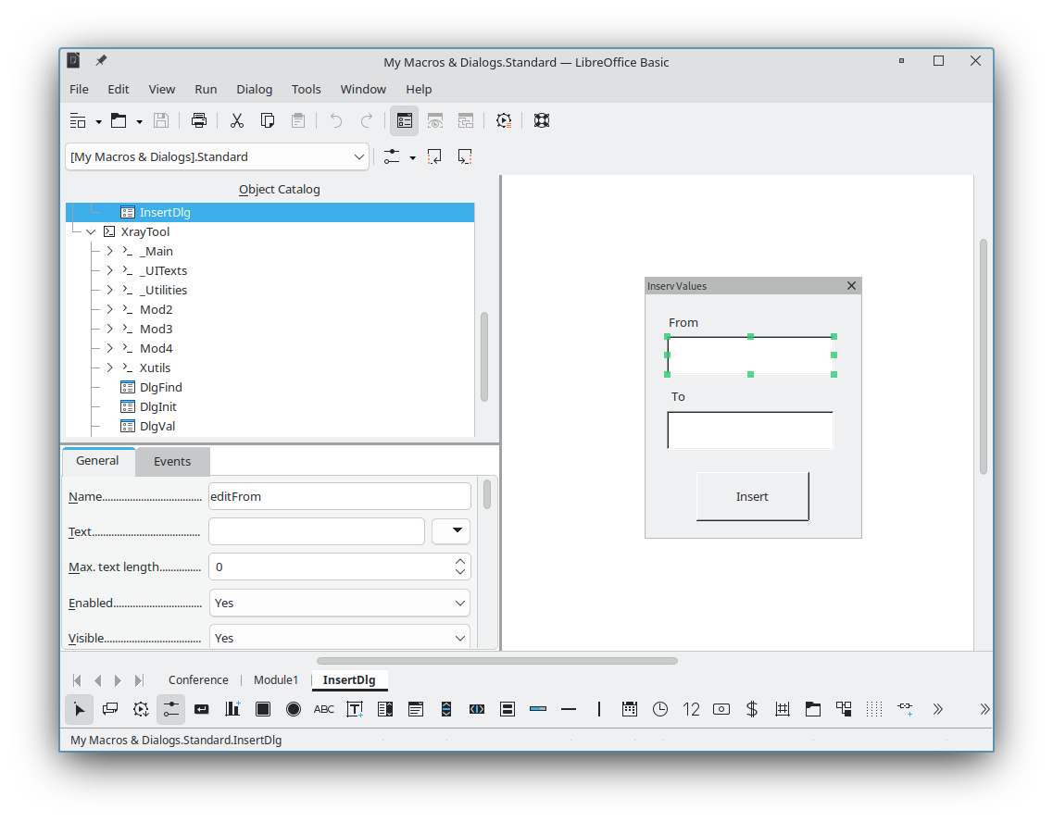
Creating Dialogs
Use the Dialog Editor to create a dialog
editFrom
editTo
btnInsert

Slide 20
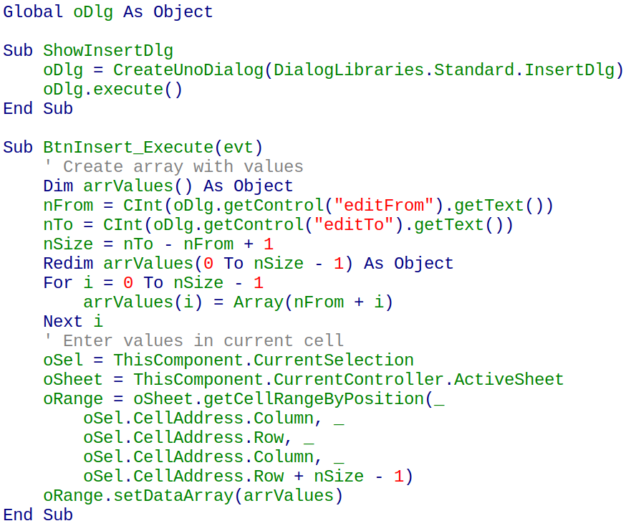
Code to open the dialog and insert the numbers

Slide 21
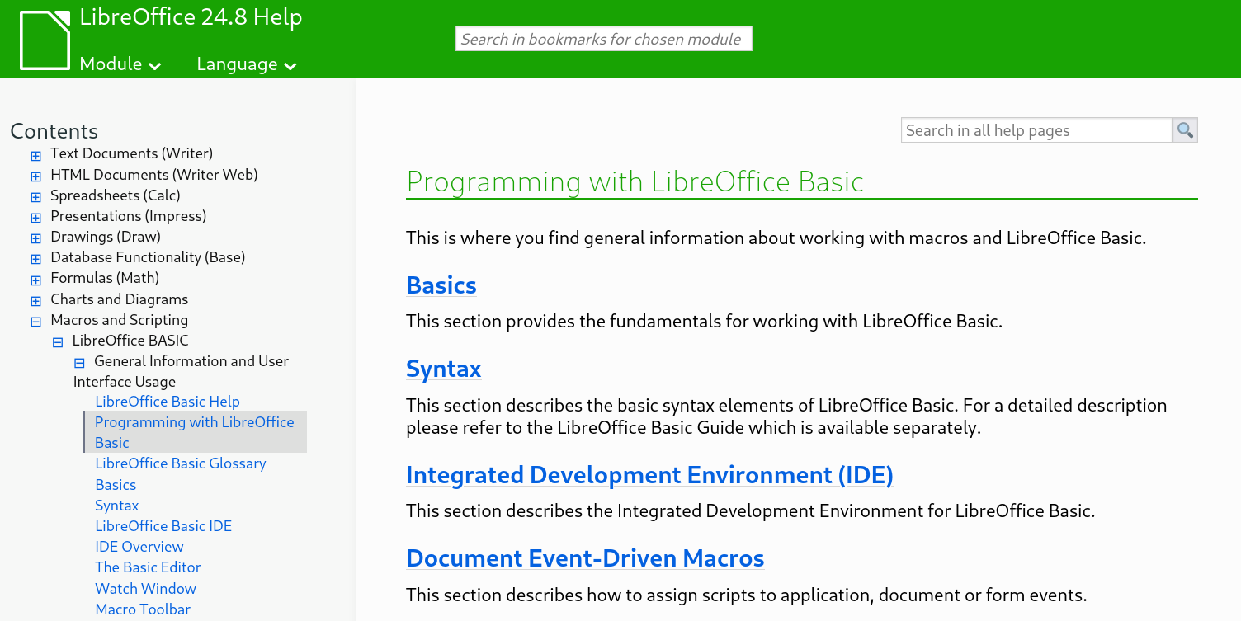
More Learning Resources
LibreOffice Basic official help pages
Link: https://help.libreoffice.org/latest/en-US/text/sbasic/shared/01000000.html

Slide 22
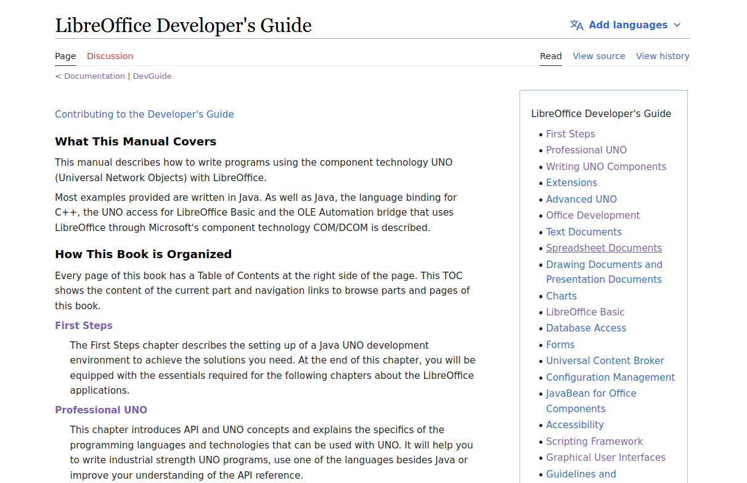
More Learning Resources
LibreOffice Developer’s Guide
Link: https://wiki.documentfoundation.org/Documentation/DevGuide/LibreOffice_Developers_Guide

Slide 23

More Learning Resources
Andrew Pitonyak’s book “OpenOffice Macros Explained”
Free to download at:
https://www.pitonyak.org/oo.php

Slide 24
Questions?

